Slide 1
Recursion in Python

Slide 2
Recursion
Problems in every area of life can be defined recursively, that is, they can be described in terms of themselves.
An English compound sentence can be described as two sentences with “and” between them.
Two mirrors facing each other produce a set of recursive images.
Mathematics defines many relationships and series with recursion, like Fibonacci numbers, factorials, inductive proofs and fractal curves.
It’s a powerful technique in programming but care must be taken. It is very easy to write an infinite loop in a recursive function!
It is done by breaking a problem down into smaller versions of the original problem

Slide 3
Recursion
Recursion is usually used in function definitions. If a function calls itself, it is recursive.
It is a control structure equivalent to a loop
Anything that is written recursively can be non-recursively (iteratively) and vice versa. This equivalence does NOT say it’s as easy to do one method as the other; some problems are more suited for recursion than others.

Slide 4
The Three Laws of Recursion
There must be a base case, that is, a path through the code which does not call the function again
There must be a recursive case, a line of code that calls the function from within the function
The call that is recursive must “move the problem towards the base case”, that is, it must make some change in the arguments of the function which will eventually mean that the base case is executed
(If this does not happen, you will have an infinite loop!)

Slide 5
Discussion of Laws
You can have more than one base case, as long as you have at least 1.
Sometimes the base case is a path which does nothing, just lets the function return instead of calling the function again.
The changes that the recursive call makes to the arguments can involve addition, subtraction, division, shortening a list, etc. But it must do something which will reduce the size of the problem

Slide 6
The Call Stack
You saw a call stack when we talked about debugging
A data structure that the program / OS uses to keep track of the function calls (with arguments) so it knows where to return to when the function is finished
The call stack typically grows and shrinks as the program progresses, getting taller when another function is called and shorter when a function returns
Recursive functions use it this way also.

Slide 7
Infinite loop in recursion
If one of the laws of recursion is broken, you can get an infinite loop in the function. The function just keeps calling itself “forever”.
When a recursive function has an infinite loop, it keeps using more and more space for the call stack (all the function calls which never return)
This ever growing structure will eventually crash / halt your program. In some languages, this crash is due to running out of RAM to put the calls in. Python has a built-in check for a call stack out of control and will stop your program before it actually runs out of memory.

Slide 8
Pros and Cons
Advantages of using recursion
A complicated function can be split down into smaller sub-problems utilizing recursion.
Sequence creation is simpler through recursion than utilizing any nested iteration.
Recursive functions render the code look simple and effective.
Disadvantages of using recursion
A lot of memory and time is taken through recursive calls which makes it expensive for use.
Recursive functions are challenging to debug.
The reasoning behind recursion can sometimes be tough to think through.

Slide 9
Examples of Recursion
Factorial of a number
Fibonacci series
Tower of Hanoi

Slide 10
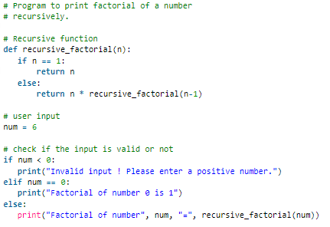
Factorial of a number

Slide 11
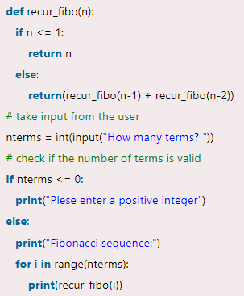
Fibonacci Series

Slide 12
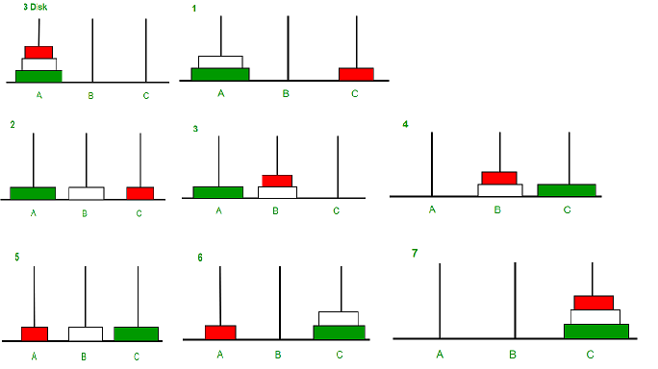
Tower of Hanoi
Tower of Hanoi is a mathematical puzzle where we have three rods and n disks. The objective of the puzzle is to move the entire stack to another rod, obeying the following simple rules: 1) Only one disk can be moved at a time. 2) Each move consists of taking the upper disk from one of the stacks and placing it on top of another stack i.e. a disk can only be moved if it is the uppermost disk on a stack. 3) No disk may be placed on top of a smaller disk.

Slide 13
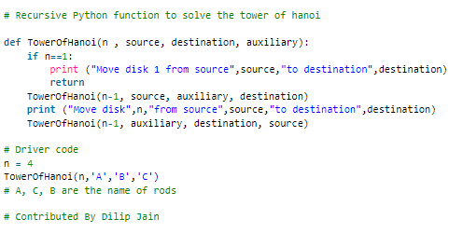
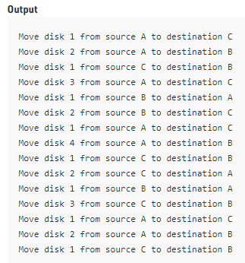
Program

Slide 14
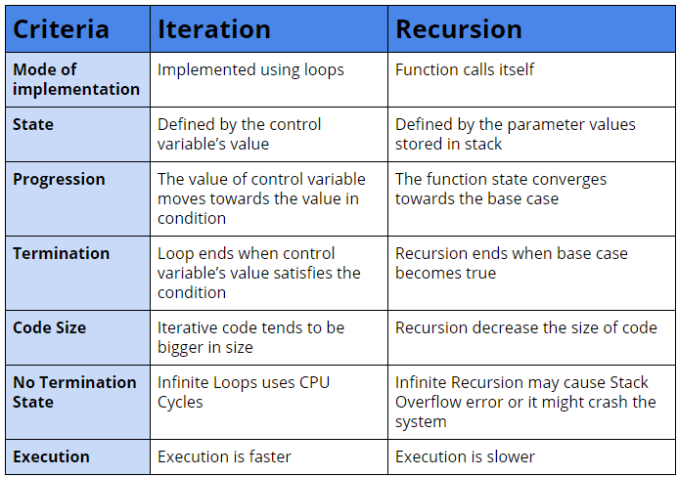
Iteration vs Recursion

Slide 15
Searching
Searching Algorithms are designed to check for an element or retrieve an element from any data structure where it is stored. Based on the type of search operation, these algorithms are generally classified into two categories:
Sequential Search: In this, the list or array is traversed sequentially and every element is checked. For example: Linear Search.
Interval Search: These algorithms are specifically designed for searching in sorted data-structures. These type of searching algorithms are much more efficient than Linear Search as they repeatedly target the center of the search structure and divide the search space in half. For Example: Binary Search.

Slide 16
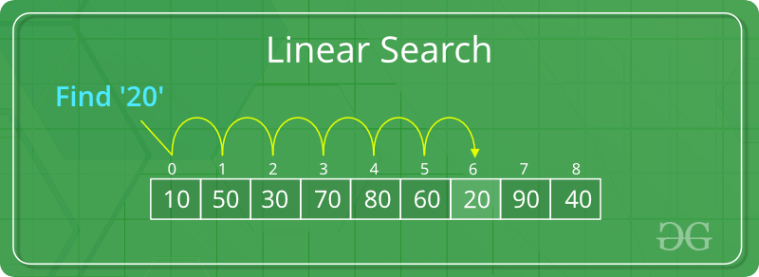
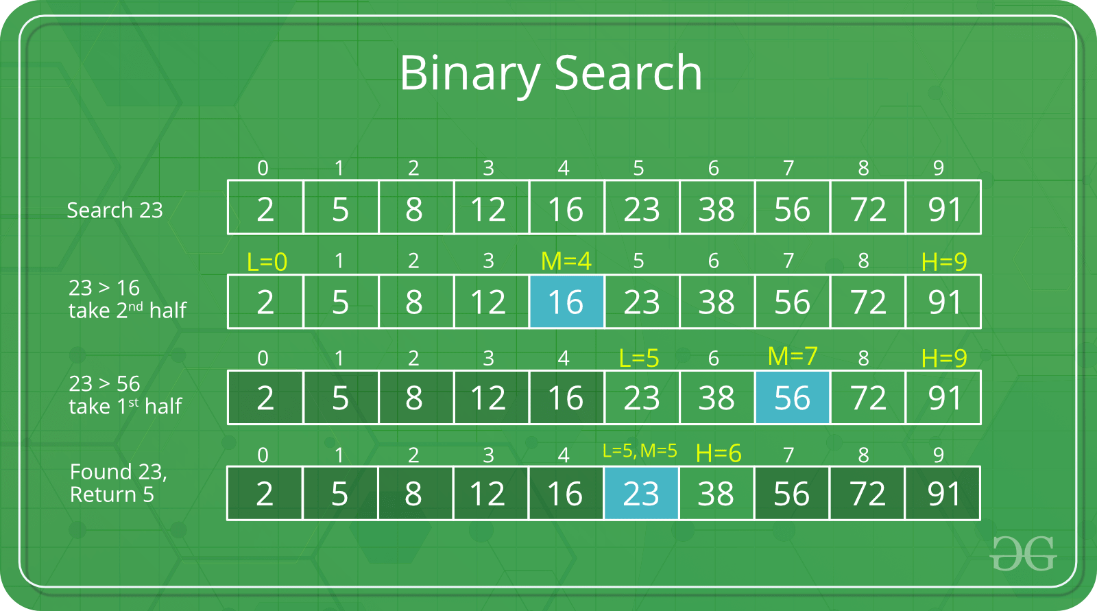

Slide 17
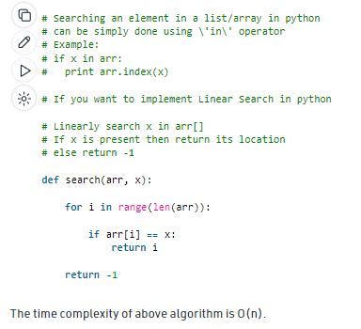
Linear Search
A simple approach is to do linear search, i.e
Start from the leftmost element of arr[] and one by one compare x with each element of arr[]
If x matches with an element, return the index.
If x doesn’t match with any of elements, return -1.

Slide 18
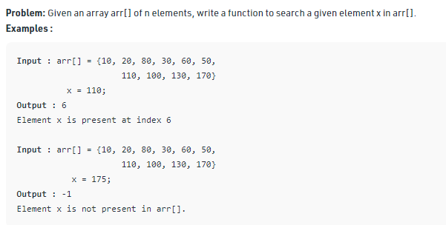
Linear Search

Slide 19
Binary Search
In a nutshell, this search algorithm takes advantage of a collection of elements that is already sorted by ignoring half of the elements after just one comparison.
Compare x with the middle element.
If x matches with the middle element, we return the mid index.
Else if x is greater than the mid element, then x can only lie in the right (greater) half subarray after the mid element. Then we apply the algorithm again for the right half.
Else if x is smaller, the target x must lie in the left (lower) half. So, we apply the algorithm for the left half.
For time complexity of binary search, visit: https://www.geeksforgeeks.org/complexity-analysis-of-binary-search/

Slide 20
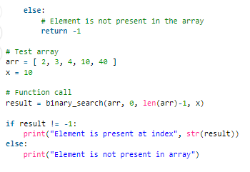
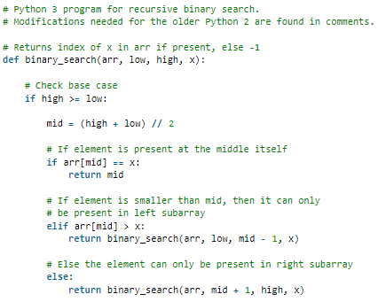

Binary Search

Slide 21
Sorting and Merging
Selection Sort
Merge List
Merge Sort
Higher Order Sort

Slide 22
Selection Sort
1. The selection sort algorithm sorts an array by repeatedly finding the smallest element (considering ascending order) from unsorted list and swapping it with the first element of the list.
2. The algorithm maintains two sub-arrays in a given array:
i. The sub-array which is already sorted.
ii. Remaining sub-array which is unsorted.
3. In every iteration of selection sort, the smallest element from the unsorted sub-array is picked and moved to the sorted sub-array.

Slide 23
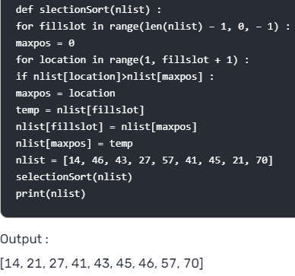
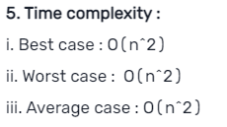
Selection Sort

Slide 24
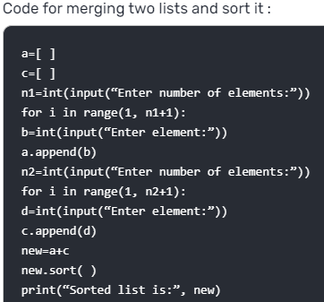
Merge List
1. Merging is defined as the process of creating a sorted list/array of data items from two other sorted array/list of data items.
2. Merge list means to merge two sorted list into one list.

Slide 25
Merge Sort
1. Merge sort is a divide and conquer algorithm. It divides input array in two halves, calls itself for the two halves and then merges the two sorted halves.
2. The merge() function is used for merging two halves.
3. The merge(arr, l, m, r) is key process that assumes that arr[l..m] and arr[m + 1 ..r] are sorted and merges the two sorted sub-arrays into one.
Merge Sort code: https://citizenchoice.in/course/Python-Programing/Unit%205/Selection-Sort-Merge-Sort-and-Higher-Order-Sort
Time complexity of Merge sort is O(n log n) in all three cases (worst,average and best) as merge sort always divides the array into two halves and take linear time to merge two halves.

Slide 26
Higher Order Sort
1. Python also supports higher order functions, meaning that functions can accept other functions as arguments and return functions to the caller.
2. Sorting of higher order functions :
a. In order to defined non-default sorting in Python, both the sorted() function and .sort() method accept a key argument.
b. The value passed to this argument needs to be a function object that returns the sorting key for any item in the list or iterable.
3. For example : Consider the given list of tuples, Python will sort by default on the first value in each tuple. In order to sort on a different element from each tuple, a function can be passed that return that element.

Slide 27
Higher Order Sort Example
>>> def second_element (t) :
... return t[1]
...
>>> zepp = [(‘Guitar’, ‘Jimmy’), (‘Vocals’, ‘Robert’), (‘Bass’, ‘John Paul’),
(‘Drums’, ‘John’)]
>>> sorted(zepp)
[(‘Bass’, ‘John Paul’), (‘Drums’, ‘John’), (‘Guitar’, ‘Jimmy’), (‘Vocals’,
‘Robert’)]
>>> sorted(zepp, key = second_element)
[(‘Guitar’, ‘Jimmy’), (‘Drums’, ‘John’), (‘Bass’, ‘John Paul’), (‘Vocals’,
‘Robert’)]

Slide 28
THANK YOU

